Slide 1

Federal Health Information Model (FHIM)

Slide 2


What is FHIM?
A Logical Information Model of Health Data developed in collaboration with the federal agencies.
Harmonizes content (information, terminologies and value sets) across federal partners and standards organizations.
Integrated with open source Model Driven Health Tools (MDHT).
Can generate IE Implementation standards for multiple implementation platforms (PSMs)
Notes:
FHIM coordinates partner agency efforts to develop healthcare terminology models (i.e., new content), and to enumerate "value sets" that can be associated with the Information Model.

Slide 3
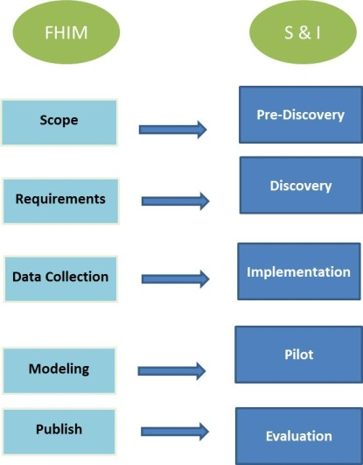
Engagement in the Standards and Interoperability (S&I) Framework
Support for Federal partner priorities such as
Meaningful Use
Direct support of Federal partner use cases
FHIM provides semantic and syntactic modeling constructs to support the definition of information
FHIM, combined with MDHT*, can be used to generate implementation standards using an MDA* approach
*MDHT - Model Driven Health Tools
MDA - Model Driven Architecture
Process Alignment
Notes:
The S&I Framework is collaborative community of public and private sector participants which establishes standards, specifications and other implementation guidance that facilitate effective HIE.

Slide 4
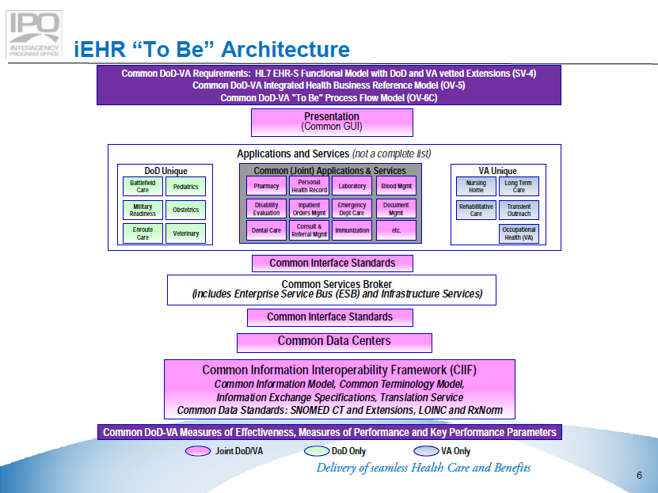
Align FHIM to the iEHR Architecture
FHIM

Slide 5
Leverage FHIM for iEHR
Bring the use cases and look at information required to support them.
Model information that moves between agencies. Information concepts that support everyone’s needs. Define value sets to support the coded information concepts.
Model and harmonize different standards with agency information in the FHIM.
FHIM uses HL7 RIM as one of its reference models. Allows specific information/structures to map to the HL7 standard.
Notes:
Implement the plan, participate and know what and how to use it

Slide 6
Summary
Freely available harmonized information models and terminologies/value sets
Integrated with open source model-driven health tools
Generates IE Implementation standards for multiple implementation platforms (PSMs), including NIEM
Supports the goals and requirements of the S&I Framework
And provides tools, software code and other artifacts to help federal partners implement the HIE implementation standards
6

Slide 7
Questions?

Slide 8
Backup

Slide 9
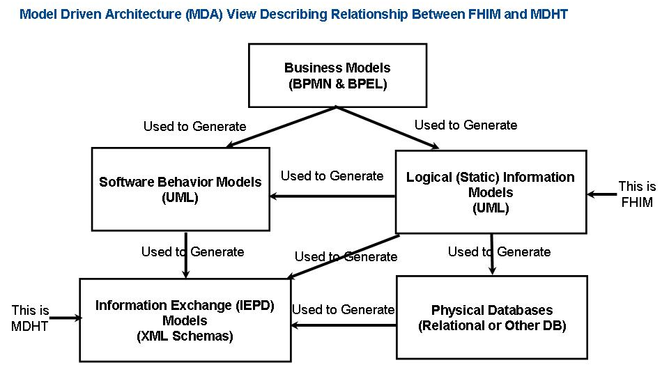
FHIM - MDA Approach

